Slide 1
Cascading Style Sheets (CSS)

Slide 2
What is CSS?
CSS stands for Cascading Style Sheets
CSS describes how HTML elements are to be displayed on screen, paper, or in other media
CSS saves a lot of work. It can control the layout of multiple web pages all at once
External stylesheets are stored in CSS files

Slide 3
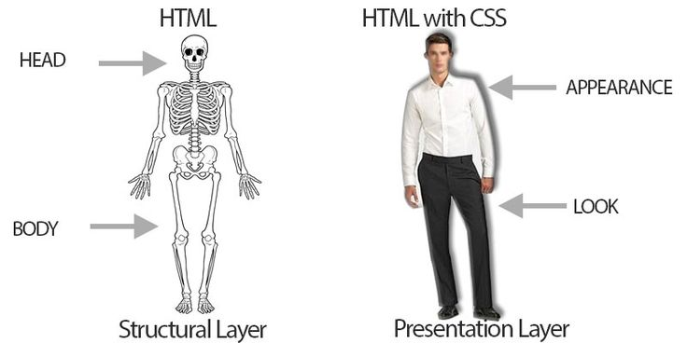
HTML CSS

